Slide 1

English Academic Writing
《学术英语论文写作》
Lecturer: Liu Xindan

Slide 2

Chapter 5
Data Collection and Evaluation

Slide 3
Data Collection and Evaluation
Chapter 5
The Role of Data in Research
Data is no longer just numbers—it is evidence, argument, and insight.
In academic writing, data supports claims, validates reasoning, and strengthens credibility.
How does data help us move from opinion to evidence-based argument?

Slide 4
Data Collection and Evaluation
Chapter 5
Data collection must usually follow certain principles and has its own specific methods.
The data collected also need to be organized, identified, summarized and classified for scientific use, thus ensuring the quality of the paper.

Slide 5
Data Collection and Evaluation
Chapter 5
The Three Dimensions of Data (3Vs)
Volume（数据量）– How much data is needed?
Variety（多样性）– What types of data (qualitative, quantitative, primary, secondary)?
Velocity（时效性）– How current must the data be for your research question?

Slide 6

Data Collection and Evaluation
Chapter 5
1. Principles of Data Collection and Selection
2. Evaluation of Data
3. Methods of Doing Research
Content

Slide 7

Data Collection and Evaluation
Chapter 5
1. Principles of Data Collection and Selection
Content

Slide 8
Data Collection and Evaluation
Chapter 5
Principles of Data Collection and Selection
1. Centered around the theme--relevance
2. True and verifiable（可证实的)
3. Typical
4. Novel

Slide 9
Data Collection and Evaluation
Chapter 5
1. Centered around the theme--relevance
There should be a clear purpose for data collection, i.e. closely centered around the theme.
Every piece of data must serve your research question.
Learn to identify: useful, less useful, irrelevant.
Tip: Write your research question at the top of every note page.

Slide 10
Data Collection and Evaluation
Chapter 5
Example Research Question:
How does remote work affect employee well-being in the tech industry?
Relevant data: Survey responses from tech employees, company wellness reports, interviews with HR managers.
Irrelevant data: A study on remote work in education, or general articles on employee happiness in retail.

Slide 11
Data Collection and Evaluation
Chapter 5
2. True and verifiable（可证实的)
Whether the materials are true, accurate and verifiable directly affects the quality of the paper.
--articles must stand the test of time--authenticity
--accuracy & verification & reconciliation
--verify all claims through cross-referencing
--first-hand materials rather than second hand
--references must be precise and accessible and not just take for granted
Can someone else trace the data back to its original source?

Slide 12
Data Collection and Evaluation
Chapter 5
Example:
If you cite “85% of employees prefer hybrid work,” ask:
Who conducted the survey?
How many people were surveyed?
Is the original report accessible?
If not verifiable, do not use it.

Slide 13
Data Collection and Evaluation
Chapter 5
3. Typical
Typical materials refer to those reflecting the essence and common characteristics of things.
--Typical materials include typical examples, data and people, ect.
--Supports generalizability and argument strength.
--They can make the article thorough, focused and forceful.

Slide 14
Data Collection and Evaluation
Chapter 5
Example:
Studying university students’ stress levels? A sample of only medical students may not be typical of all students.
A typical sample would include students from arts, sciences, engineering, and business.

Slide 15
Data Collection and Evaluation
Chapter 5
4. Novel
Academic papers that have novel and vivid materials attract more readers and expand their influence.
--unique role of old materials cannot be ignored when emphasizing new materials.
Balance: Use novel data to break new ground, but don’t ignore classic sources.

Slide 16
Data Collection and Evaluation
Chapter 5
Example:
Many studies discuss climate change policy.
A novel approach: Use 2025 survey data from small island nations to show how rising sea levels are reshaping local legal systems.

Slide 17
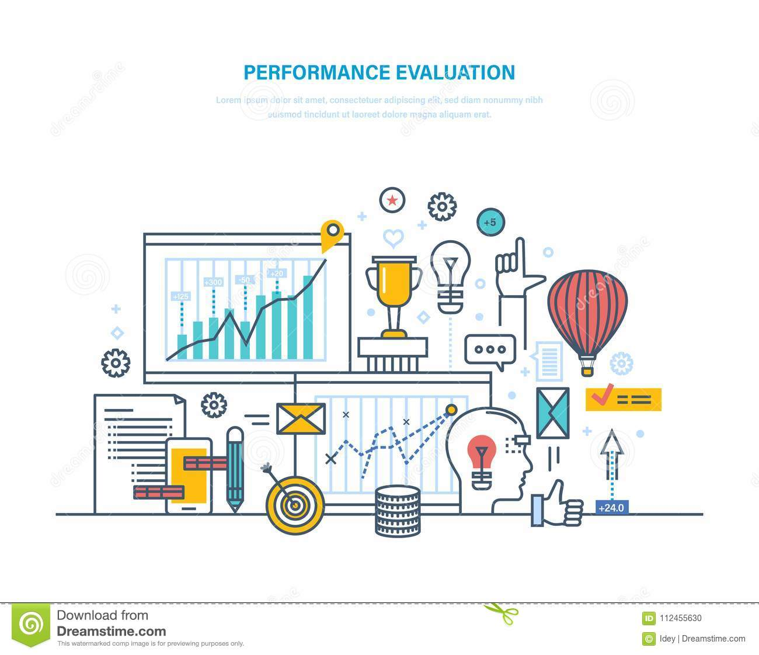
Data Collection and Evaluation
Chapter 5
2. Evaluation of Date

Slide 18
Data Collection and Evaluation
Chapter 5
Being Critical ≠ Being Negative
Being critical means:
Questioning assumptions
Identifying bias
Evaluating evidence

Slide 19
Data Collection and Evaluation
Chapter 5
2.1 Reading a specialized book
Table of contents, index, preface, appendices
three skims
Skim the table of contents--Skim the index--Skim the interesting texts

Slide 20
Data Collection and Evaluation
Chapter 5
2.2 Reading a research paper
Abstract → Introduction → Conclusion → Methods → Results
SRS Method:
Skim → Read → Study

Slide 21
Data Collection and Evaluation
Chapter 5
Four lenses: Structure, Purpose, Audience, Author
Structure--books
Look at the table of contents.
Skim the preface or introduction to establish context for the discussion and determine the author’s intent.
Glance at any appendices, diagrams, tables, or figures and see what kinds of things make it into the endnotes section if there is one.

Slide 22
Data Collection and Evaluation
Chapter 5
Structure--articles
read the “abstract” for a summary
read the background or introduction section which will normally have some kind of “literature review” or summary of what others have said
read the conclusions or discussions

Slide 23
Data Collection and Evaluation
Chapter 5
Purpose
What is the author trying to do?
What is his or her bias?
Any assumptions to be challenged?
Look at the publisher or institutional / organizational affiliation of the author.
Does the person have a vested interest?

Slide 24
Data Collection and Evaluation
Chapter 5
Audience
Who is the potential audience?
Why would the audience be reading the text?

Slide 25
Data Collection and Evaluation
Chapter 5
Author
Who is the author?
Is it someone a professor has mentioned or one that you come across in the course of other reading?
Has the person been mentioned in other texts or bibliographies of other texts?
Is the person a teacher or researcher from a reputable academic institution?
Does the person have considerable knowledge of what he or she is talking about?
Is the author respected and well-received?

Slide 26
Data Collection and Evaluation
Chapter 5
Evaluating Web Sources
Key Criteria for Web Sources:
Authorship
Publishing body
Point of view / bias
Referral to literature
Accuracy of details
Currency
Not everything on the internet is a “source.”

Slide 27
Data Collection and Evaluation
Chapter 5
2.3 Primary and secondary sources
Primary sources: Original data, creative works, firsthand accounts
Examples: diaries, poems, raw survey data, novel, play, letter, or other creative works
Secondary sources: the second-hand information, interpretations, summaries, analyses by others
Examples: articles, textbooks, literature reviews, critiques
Use primary sources for evidence; use secondary sources for context.

Slide 28
Data Collection and Evaluation
Chapter 5
A diary from a WWII soldier A textbook chapter on WWII
Raw data from a COVID-19 vaccine trial A news article summarizing the trial results
A recording of a political speech A biography analyzing the speech
Primary Source Example
Secondary Source Example

Slide 29
Data Collection and Evaluation
Chapter 5
(1) Collecting primary sources
Common Methods:
Experiments
Textual analysis (highlighting, annotating, margin notes)
Interviews
Questionnaires
Tip: When reading a primary text actively, mark it up—underline, scribble, stick notes.

Slide 30
Data Collection and Evaluation
Chapter 5
(2) Collecting secondary sources
Library Search Strategies:
By title, author, subject, keywords
Use encyclopedias for background and references
Explore biographical sources, yearbooks, atlases, gazettes
Online Databases

Slide 31
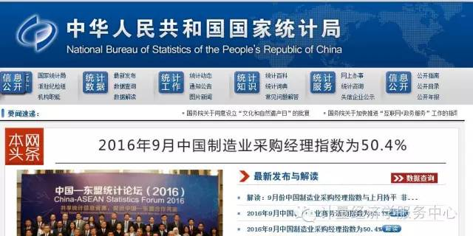
国家统计局http://www.stats.gov.cn/

Slide 32
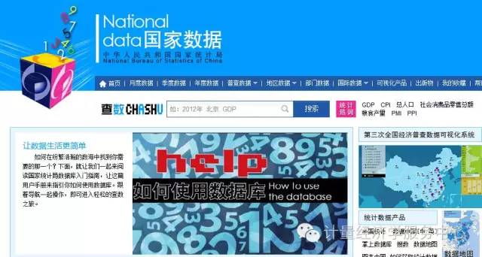
国家数据 http://data.stats.gov.cn/index.htm

Slide 33

万德 http://www.wind.com.cn/

Slide 34
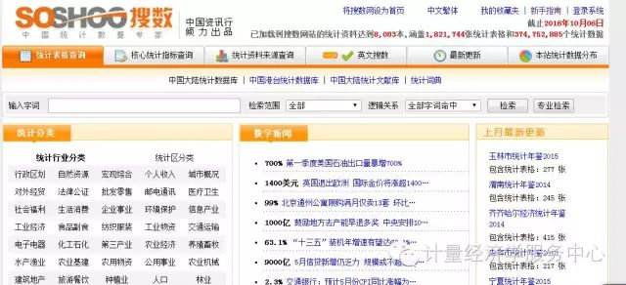
搜数网 http://www.soshoo.com/

Slide 35
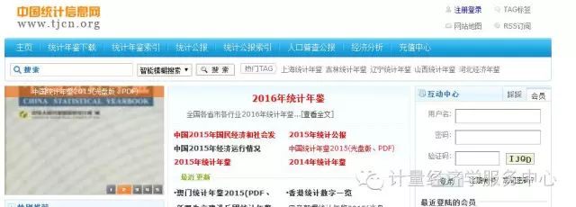
中国统计信息网 http://www.tjcn.org/

Slide 36
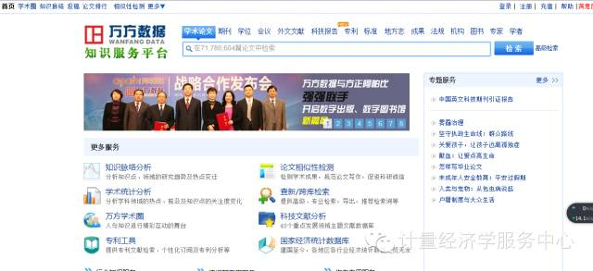
万方数据库

Slide 37
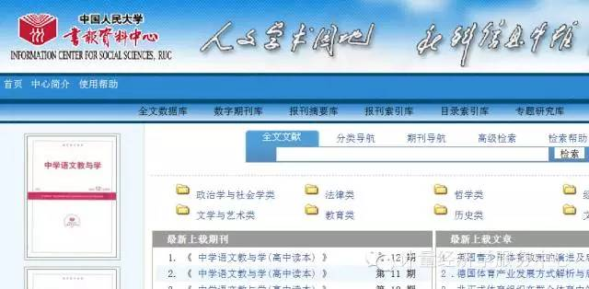
人大复印

Slide 38
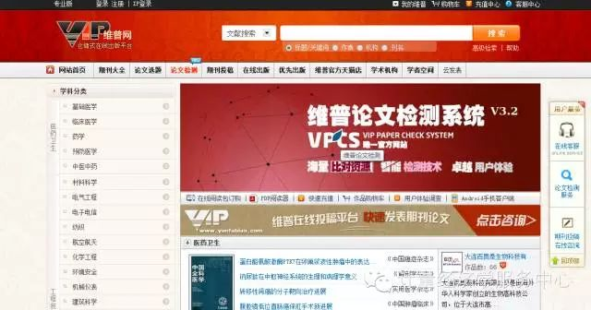
维普

Slide 39

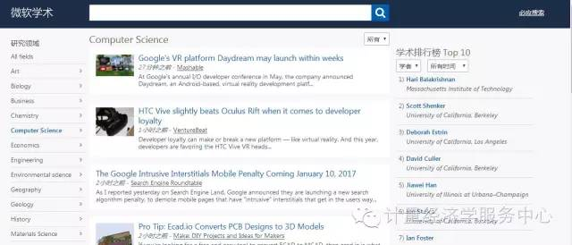
微软学术搜索http://academic.research.microsoft.com/

Slide 40
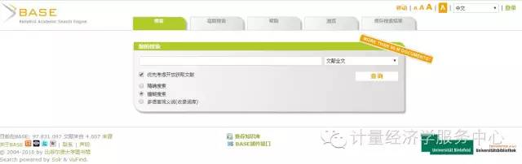
德国base学术搜索http://www.base-search.net/

Slide 41
Data Collection and Evaluation
Chapter 5
2.3 Evaluating your references
Always use the most recent version of a source
Compare what different sources are saying
Consider where the author has acquired his information
Check the author’s biography
Check a source’s facts and figures

Slide 42
Data Collection and Evaluation
Chapter 5
2.4 Four Methods of Data Collection
Census: a study that obtains data from every member of a population.( not
practical)
Sample survey: a study that obtains data from a subset of a population.
Experiment: a controlled study to understand cause-and-effect
relationships.
Observational study: to understand cause-and-effect relationships but
you can not control the experiments.

Slide 43
Data Collection and Evaluation
Chapter 5
2.5 Take Notes
(1) What to write down?
(2) Specific tips to avoid plagiarism

Slide 44
Data Collection and Evaluation
Chapter 5
(1) What to write down?
Anything and everything that will flesh out the thesis statement or research question.
Duplicating facts: these may be needed later for the defense of thesis.
Contradictory information: acknowledging an opposing viewpoint that is easily
disproved by its counterpoint is always a good rhetorical tool.
Notes from more than one or two key sources.

Slide 45
Data Collection and Evaluation
Chapter 5
A working bibliography of all the sources consulted. Before even taking notes, neatly record all the pertinent bibliographical information needed for any citation format chosen, including author, title, (editor, translator, and/or edition number if there is one) publisher, city of publication, year of publication, issue number, volume, and page numbers.
The call number of a book, the search terms entered into any database, and any URLs (website addresses) for online information for easy re-access to a resource.

Slide 46
Data Collection and Evaluation
Chapter 5
(2) Specific tips to avoid plagiarism
Paraphrase most of the time, that is, compress and write in your own words that you understand to be the basic meaning of a sentence or a block of text.

Slide 47
Data Collection and Evaluation
Chapter 5
Original text:
“Remote work can lead to increased job satisfaction, but only when employees have adequate home office setups and social support from managers.”
Sentence 1: Working from home only boosts job satisfaction if workers have proper home offices and receive managerial support.
Sentence 2: Working from home may enhance job satisfaction, yet this positive effect depends on employees having both appropriate home office arrangements and sufficient managerial social support.

Slide 48
Data Collection and Evaluation
Chapter 5
(2) Specific tips to avoid plagiarism
Though it should be limited, if a direct quotation must be taken,
--highlight it in a different colored pen,
--put huge quotation marks around it, and
--include the page number and source.

Slide 49
Data Collection and Evaluation
Chapter 5
3. Methods of Doing Research

Slide 50
Data Collection and Evaluation
Chapter 5
Quantitative research:
It is based on scientific method. It purports to be as objective as possible, and is often based on statistics or other measurable, empirical data. Conclusions will be drawn from the analysis of things clearly measured.

Slide 51
Data Collection and Evaluation
Chapter 5
Qualitative research:
It is often based on subjective data items, which cannot be given a numeric value, for
example the attitudes and opinions of a range of individuals on an issue.
Anthropological study, for example, may be based on small details of people’s
experience, collected through observation. These will be described in words rather
than numbers, and statistical generalisations cannot be drawn from them.

Slide 52
Data Collection and Evaluation
Chapter 5
In practice, few dissertations involve only qualitative or only quantitative methods. Where will your focus lie? The answer should depend upon the kind of enquiry you are engaged in: again, ask your supervisor for advice about this.

Slide 53
Exercise 1--Evaluating Resources
When writing a paper with the following research question:
Has the modern women’s movement forced the Roman Catholic Church to consider allowing women to take leadership positions with the Church?
Which of the following sources would initially be evaluated as useful?

Slide 54
Exercise 1--Evaluating Resources
1. The International Encyclopedia of the Social Sciences, 1968.
2. An article entitled “The History of Women and the Church” in a 1992 copy of the
journal Church and Society.
3. A book:Growing Up Catbolic:An Infinitely Funny Guide for the Faitbful, the Fallen,
and Everyone In-Between.
4. A book entitled Feminist Theory:The Intellectual Traditions of American Feminism.
5. An article entitled “A Symposium on the Catholic Ethic and Feminism”, in the
International Journal of Politics, Culture, and Society published in 1995.
6. An article entitled “Feminism Corrupts the Church” in The Catholic Digest magazine
published in 1995.

Slide 55
Exercise 2--Identifying Relevant Sources
Research Question:
Does social media use affect sleep quality among university students?
Which of the following sources would be most useful? Why?
1. A 2010 book: The History of Social Media Platforms
2. A 2023 journal article: “Screen Time and Insomnia in Young Adults”
3. An interview with a software engineer who designs social media apps
4. A survey of 500 university students about their nighttime social media habits and sleep
duration

Slide 56
Exercise 3--Evaluating a Web Source
You find this webpage:
Title: “Why Vaccines Are Dangerous”
Author: Anonymous
Publisher: NaturalHealthTruths.com
Last updated: 2008
References: None
Questions:
Is this source credible? Why or why not?
What criteria from the “Evaluating Web Pages” section does it fail?

Slide 57
Exercise 4--Primary or Secondary Resources
Classify each as Primary (P) or Secondary (S):
1. A diary written by a nurse during the 1918 flu pandemic
2. A textbook chapter on pandemic history
3. Raw data from a 2024 study on air pollution and asthma
4. A news summary of that same study

Slide 58
Exercise 5: Short Answer – Justify Your Method
Scenario: You want to study how first-year graduate students experience academic stress.
Question:
Would you use quantitative, qualitative, or mixed methods? Give one reason.

Slide 59
Thank you!

